Slide 1
AM-GCN: Adaptive Multi-channel Graph Convolutional Networks
汇报人：Gu Tang
时间：2020.11.23
Conference：KDD_2020
Github: https://github.com/zhumeiqiBUPT/AM-GCN

Slide 2
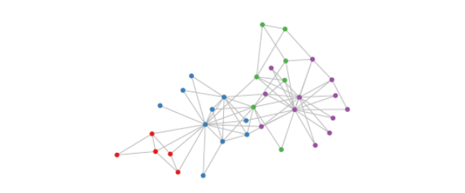
Motivations
some recent studies raise concerns about whether GCNs can optimally integrate node features and topological structures in a complex graph with rich information
GCN ?

Slide 3
Case 1: Random Topology and Correlated Node Features
We generate a random network consisting of 900 nodes, where the
probability of building an edge betweean any two nodes is 0.03.
Each node has a feature vector of 50 dimensions. To generate node
features, we randomly assign 3 labels to the 900 nodes, and for
the nodes with the same label, we use one Gaussian distribution
to generate the node features. The Gaussian distributions for the
three classes of nodes have the same covariance matrix, but three
different centers far away from each other. In this data set, the
node labels are highly correlated with the node features, but not
the topological structures.
GCN MLP
ACC:
75.2% 100%

Slide 4
Case 2: Correlated Topology and Random Node Features
We generate another network with 900 nodes. This time, the node features, each of 50 dimensions, are randomly generated. For the topological structure, we employ the Stochastic Blockmodel (SBM) to split nodes into 3 communities (nodes 0-299, 300-599, 600-899,respectively). Within each community, the probability of building an edge is set to 0.03, and the probability of building an edge between nodes in different communities is set to 0.0015. In this dataset, the node labels are determined by the communities, i.e., nodes in the same community have the same label.
GCN Deep Walk
ACC:
87% 100%

Slide 5
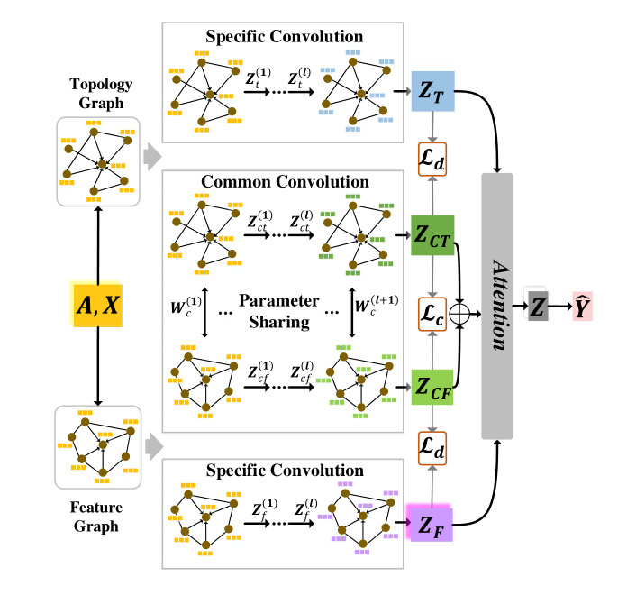
AM-GCN

Slide 6
CoSan Prepare-data

Slide 7
CoSan-Framework

Slide 8
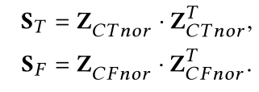
CoSan-Framework

Slide 9
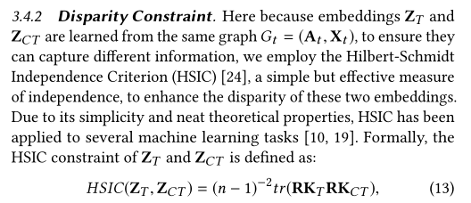
CoSan-Framework

Slide 10
CoSan-Framework

Slide 11
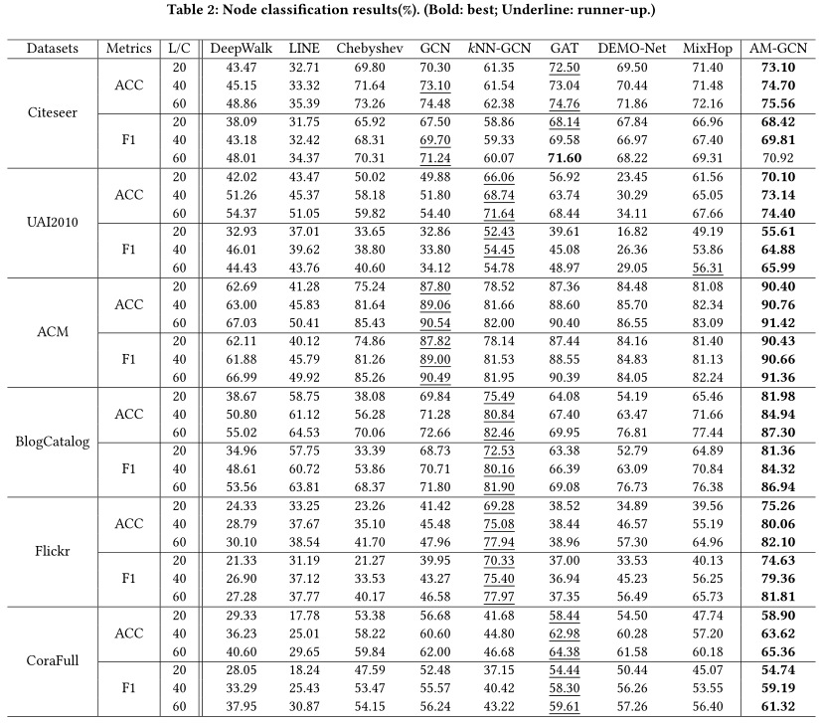
Experiment

Slide 12
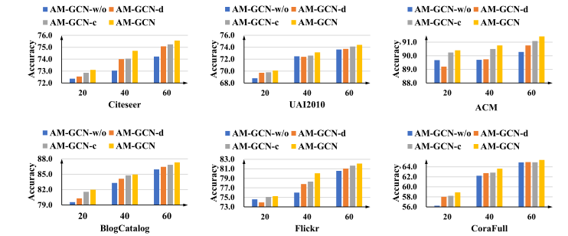
Experiment

Slide 13
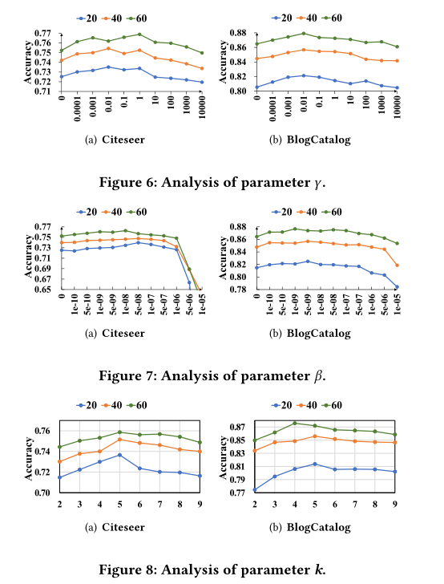
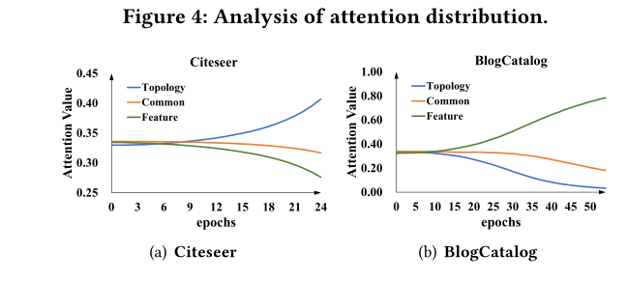
Experiment

Slide 14
THANGKS!

